Slide 1
Introduction to ajax
Zaheer sheikh

Slide 2
What is ajax
Ajax Stand for Asynchronous JavaScript and XML. Ajax is user experience with the help of ajax, we an communicate with server without page reload.
AJAX is a technique for creating fast and dynamic web pages.
AJAX allows web pages to be updated asynchronously by exchanging small amounts of data with the server behind the scenes. This means that it is possible to update parts of a web page, without reloading the whole pages.

Slide 3
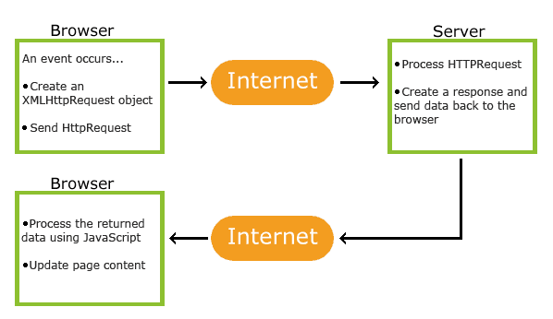
How ajax works

Slide 4
Types of ajax
Asynchronous Ajax Asynchronous means that the script will send a request to the server and continue its execution without waiting for the reply. As soon as reply is received a browser event is fired, which in turn allows the script to execute associated actions.
Synchronous Ajax Synchronous Ajax request is the process in which execution of the request stops until a response is received and Asynchronous Ajax request means the script continue the process without waiting for the server to reply. It will handle the reply if it arrives.
By default, Ajax request is Asynchronous but sometimes you need to send your request synchronously.
// Request example
var sync_request = $.ajax({
url: "example.php",
async: false,
success: function(data){
//response script here
}
});

Slide 5
disadvantages of ajax
Search Engines cannot index Ajax pages can not be indexed by Google as well as other search engines.
Open-source. View source is allowed, and anyone can view the code source written for Ajax, which makes it less secure compared to other technologies.

Slide 6
Thank you
By Zaheer Sheikh

